Slide 1
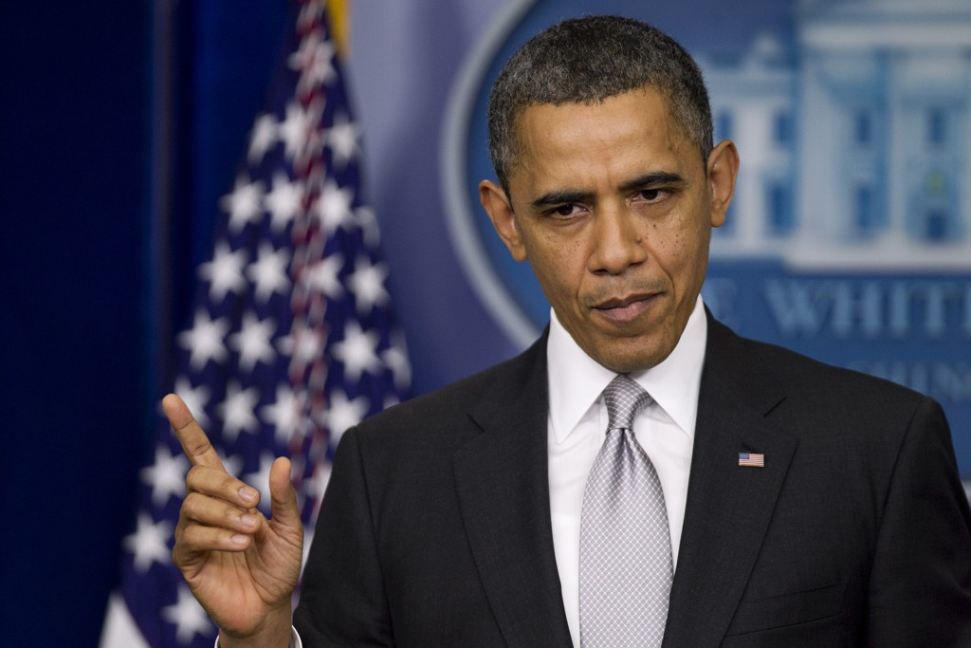
Oral Presentation
“Let’s Be Clear”

Slide 2
Goals
Understanding how meaning is constructed in film using film language.
Deep analysis of 5 minute excerpt of a film and how it is important to the film as a whole through cinematic terms.

Slide 3
6 Requirements within Presentation
Social- cultural Context
Genre
Reception by Audience and Critics (HL)
Reason for Selecting Extract
Director’s Intent
Relationship of the extract to the Rest of the film (cinematic terms).

Slide 4
1. Social-Cultural Context
What was going on when this film was made? How does it relate to the culture or society?
Exp. If the movie was made about the Civil War, Don’t talk about the civil war. Talk about how in the 1990’s the movie industry was fixated on war movies and how the new special effects influenced the realism of battle scenes.

Slide 5
2. Genre
Describe how the film and the and excerpt fit into the genre.
Describe through story but mainly cinematic terms (lighting, camera, sound, etc)

Slide 6
3. Reception to Audience and Critics
Audience and Critics recreations then and now.
Quote articles and critics to add validity.
  You can Read Quotes!!!!
Don’t just go to rotten tomatoes!
  Find well known critics and articles to quote

Slide 7
4. Reason for Selecting the Extract
Why did you choose it? How does it influence the rest of the movie.
If its a critical plot point, tell us that but then explain why.

Slide 8
5. Director’s Intent (Extract)
What was the director trying to do in the extract?
  Character development
  Symbolism
  Foreshadowing
  (Explain through cinematic terms)

Slide 9
6. Relationship of the Extract to the Rest of the Film
What is it’s role in the film?
How do the cinematographer’s cinematic elements show themselves in this 5 minutes and do the same elements repeat throughout the film?
Is it a good example of the style of the film as a whole?

Slide 10
Common Pitfalls
Forgetting one Requirement.
No shot by shot descriptions! Tell us why it’s a low angle shot!
Don’t describe narrative or plot. Examiners want cinematic analysis.
Don’t just state the facts, analysis. Tell us why something is...
Examiners don’t want behind the scenes information unless relevant to other requirements. (not scored)
Don’t just give a list of awards the movie received. Find meaningful reviews and reactions then and now.

Slide 11
Tips
Make it easy for the Examiners:
  State what Requirement you are commenting on. (The social-cultural context is...
- have clear sections and try not to flip flop from point to point.
Label your Q Cards with the requirements OR color code your notes.
Insert film critic quotes (when relevant) into different areas of analysis.
Mention Names!!! director’s, cinematographer, sound artists, ext.

Slide 12
When You Present
Fill out Coversheet
Beginning Paragraph “Hello, my name is..”
Once we begin recording, there is not stopping, no do overs.
I will give you time reminders.
No penalty for under time (you will not score well though)
If you go over-time, nothing said after the max is counted.

Slide 13
Starting Paragraph
Hello, my name is _______________________________.
My Candidate number is ___________________________ .
School number is ______________________________.
The film I selected is _________________________. The except I chose for my oral presentation occurs __________________________ and it is when _________________________________________________________________________________________________________________________________________________________________________________________________.

